Slide 1


EUREKA
1.6.2026
Jukka Mäki
Funding Services, Business Finland

Slide 2

What is Eureka?
  Intergovernmental collaboration platform that is separate from the EU Framework Programme
  Extensive network with European roots; today around 45 participating countries globally and the EU (e.g., KR, CA, ZA)
  Focus on industrial and business applications, “bottom-up”
  Flexible configurations of countries participating in each specific call
  www.eurekanetwork.org

Slide 3
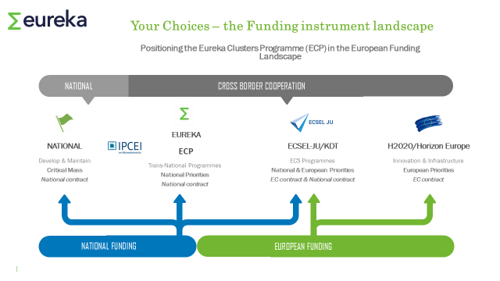

Eureka Instruments in the European Landscape

Slide 4
EUREKA Instruments and Business Finland Funding Services
  EUREKA Clusters Program – funding and project management support for collaborative R&D performed jointly by international value chains and consortia
  Eurostars Program – funding for international R&D collaboration of innovative SME’s
  Globalstars – platform for global collaborations (bi- and multilateral calls outside Europe)
  Network projects – support for free-form bottom-up collaborative projects

Slide 5
Eureka Clusters – Key Characteristics
Public-Private Partnerships – industry led, supported by national funding bodies like Business Finland
Involvement of key European industries (software, telecom, ECS, but also automotive, aviation, energy, …)
5 different clusters, each with its own focus and joint calls
A good fit for tech companies seeking long term innovation and business collaborations within European value chains
  Engage through PO-Day events or by connecting to an active partner
  Be in contact with Business Finland at an early stage

Slide 6
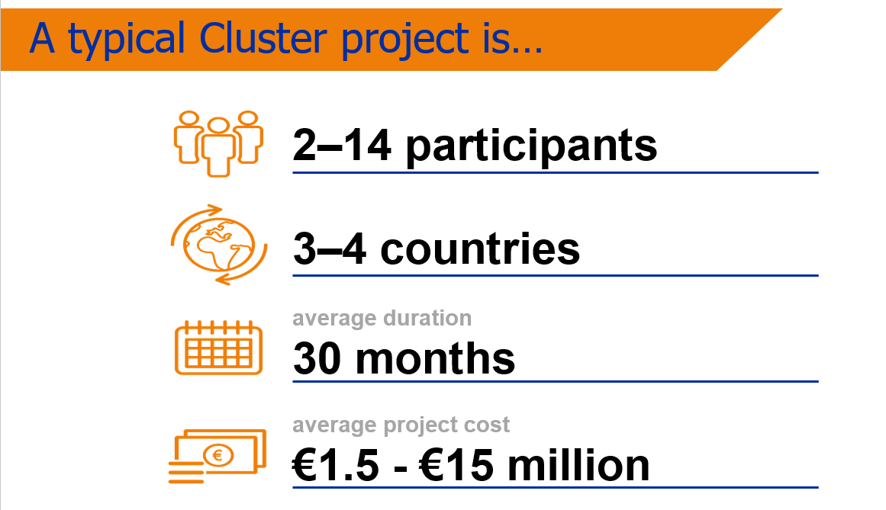

The Characteristics of a Cluster Project

Slide 7

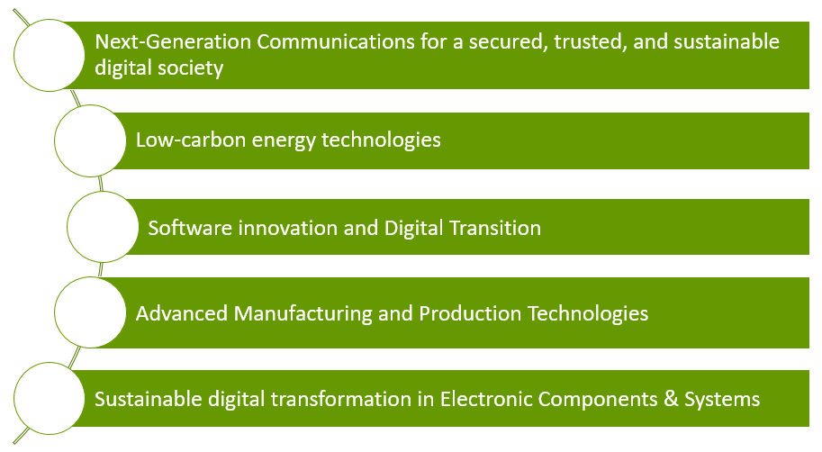
Eureka Clusters in the European Landscape
www.celticnext.eu
www.eurogia.com
www.itea3.org
www.smarteureka.com
www.eureka-xecs.com/

Slide 8
For innovative SMEs: Eurostars
  Eurostars supports international R&D collaborations for innovative SMEs
  Flexible, relatively small administrative burden
  One joint ranking list for projects from all countries, funding starting from the top until the reserved money is use
  Contact the contact person of your company at BF and/or Eurostars contact persons when planning a possible project, well before filing an application
Notes:
SMEs with a headcount of 100 FTE employees or fewer must:
have at least 5.0 FTEs dedicated to R&D activities
or dedicate at least 10.00% of their FTE to R&D activities
or dedicate at least 10.00% of their turnover to R&D activities.
SMEs with a headcount of more than 100 FTE employees:
have at least 10.0 FTEs dedicated to R&D activities
or dedicate at least 10.00% of their FTE to R&D activities
or dedicate at least 10.00% of their turnover to R&D activities.
This and all other eligibility criteria are described in detail in the Guidelines.

Slide 9
More Information
Network Projects & Globalstars: Jukka Mäki
Eurostars: Jukka Lohivuo
Celtic: Hannu Nurmi
ITEA: Teemu Varonen
Xecs: Veli-Pekka Ihanus
SMART: Marko Ylikorpi
Sähköposti: etunimi.sukunimi@businessfinland.fi

